Slide 1

DEPARTMENT OF ELECTRONICS AND COMMUNICATION ENGINEERING IV ECE-C minor Project – Phase -II-Batch-8 A.Y. 2022-2023
Implementing Advanced Train Ticket Booking System Using QR Code
Team Members | Parisi Chinni Sri Venkata Sai-19R21A04G0
 | Potharla Sai Abhinav-19R21A04G5
 | Jaddu Venkata Rama Subhash-19R21A04E1
 | M Umesh Chandra-19R21A04F1
Project Guide | Mrs. M.Sailaja mam

Slide 2
LIST OF CONTENTS
Aim & Objective
Abstract
Literature survey
Existing system
Proposed system
Components
Block diagram
Methodology and Results
Conclusion and Future scope
References

Slide 3
Aim & Objective
AIM:
To improve availability of seats in the ongoing trains and a system which provides spot booking of seats.
Objective:
To Abolish corruption in Indian Railways.
To help digitalization in Indian Railways.
To generate QR’s on railway tickets.

Slide 4
Abstract
Train journey is the most exciting and most enjoyable experience of everyone’s life.
But in this passenger's starts facing a problem named out of tickets.
In another hand the majority of the tickets are wasted because passengers are unable to board the trains for a variety of reasons.
TC’s are exploiting this situation by part exchange with money for vacant seats, which leads to corrupt practices and a variety of other frauds.
The Internet of Things is one of the technologies that makes our daily lives easier by providing solutions to many of these problems

Slide 5
Literature survey
[1] Kajal Hargunani, Pranita Kengar, Rishal Gawade Sunil Kumar More, Prof. Meghana Lokhande “Integrated Bus System Using QR code” 2018 IEEE Fourth International Conference on Computing Communication Control and Automation (ICCUBEA)

Slide 6
Cont.…
The main objective of this paper is to enhance the QR system in bus for tickets.
The requirements used in the journal are
1. QR code.
2. Interfacing Application.
3. Cloud Data exchange.
4. GPS.
To avoid traffic problems and to promote for usage of public transport we are proposing such a system.
In this system commuters will be able to track the bus with the help of smart phone by scanning the QR (Quick Response) code placed at the bus stop to view estimated arrival time of bus, current location of bus, and bus routes on a map is proposed.

Slide 7
Cont.….
[2]Asri Nuhi ,Florinda Imeri , Agon Memeti, Betim Cico, “Smart Attendance System using QR Code” 2020 9th MEDITERRANEAN CONFERENCE ON EMBEDDED COMPUTING (MECO), 8-11 JUNE 2020, BUDVA, MONTENEGRO

Slide 8
Cont….
The regular attendance system continued in the educational system where the instructor announced the name of every single student and marked the attendance, causing time wastage during address time.
Burden of the present system is the opportunity for the student to stamp fake attendance.
These days mobile phones can tackle the vast majority of the issue rapidly and without any problem.
The proposed framework has three segments:
one for producing the QR Code by entering the student's subtleties
second application for taking the attendance
third for creating the attendance in CSV or XLS design.

Slide 9
Cont…
[3] ”A Smart Bus Tracking System Based on Location-Aware Services and QR Codes”, Innovations in Intelligent Systems and Applications (INISTA) Proceedings, 2014 IEEE International Symposium,Alberobello,DOI:10.1109/INISTA.2014.687 36 34

Slide 10
Cont…
The paper presents a smart bus tracking system that uses location-aware services and QR codes to enhance the efficiency of public transportation.
The proposed system allows passengers to track the location of the bus in real-time using their smartphones or other mobile devices.
The system utilizes QR codes placed on the bus stops, which can be scanned by the passengers to access information on the current location and expected arrival time of the bus.
The system also provides other useful features, such as notifications to passengers about delays or route changes.
The authors argue that the proposed system can improve the overall user experience and increase the efficiency of public transportation, which can lead to reduced traffic congestion and air pollution.

Slide 11
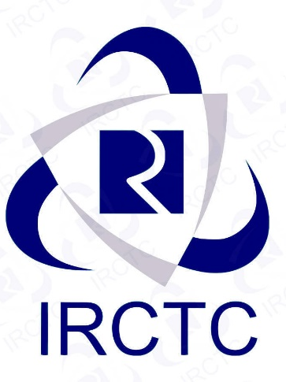
EXISTING SYSTEM
Existing system 1: IRCTC
IRCTC (Indian Railway Catering and Tourism Corporation) is a subsidiary of the Indian Railways that handles the online ticketing, catering, and tourism operations of the Indian Railways.
The IRCTC website and mobile application allow users to book train tickets online, check the availability of seats, and make payment through various payment options.
IRCTC also offers a range of other services, such as tourism packages, hotel bookings, and e-catering services.
IRCTC has made significant efforts to improve the user experience and efficiency of its services. It has introduced measures such as Tatkal booking, which allows passengers to book tickets at short notice, and the use of Artificial Intelligence (AI) to predict the chances of ticket confirmation.
IRCTC also offers various payment options, including credit/debit cards, net banking, and e-wallets, to make the payment process more convenient for users.

Slide 12
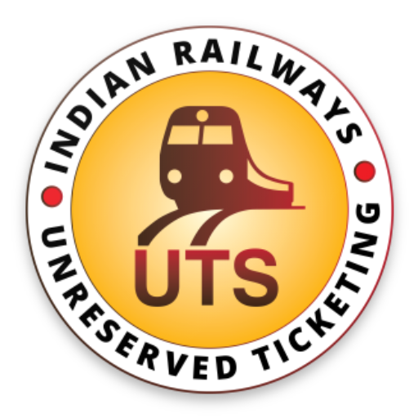
Cont…
Existing System 2: UTS
UTS (Unreserved Ticketing System) is an initiative by the Indian Railways to provide a paperless and cashless system for booking unreserved train tickets.
The UTS mobile application, available for both Android and iOS devices, allows passengers to book and purchase unreserved tickets digitally, without the need for physical tickets or cash.
The UTS app uses GPS technology to detect the location of the passenger and suggests the nearest station for ticket booking.
Passengers can select their destination station, the type of ticket, and the number of tickets required, and make payment through various digital payment options, including UPI, credit/debit cards, and e-wallets.
The app also provides the facility to cancel or reschedule the booked tickets.
The UTS system has been implemented across various zones of the Indian Railways, and has proved to be a convenient and efficient solution for booking unreserved tickets, particularly for daily commuters.
The system has reduced the long queues and waiting time at ticket counters, and has also helped in promoting a paperless and eco-friendly environment.

Slide 13
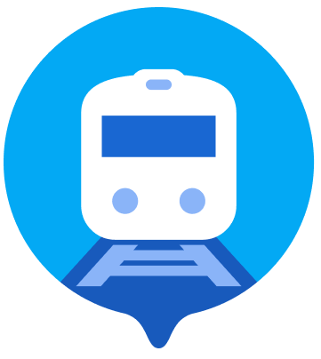
Cont…
Existing system 3: Where is my train
"Where is my train" is a mobile application that provides real-time train tracking and related services to users in India.
The app allows users to track the current location and expected arrival time of trains, as well as access information about train schedules, seat availability, and ticket booking.
One of the key features of the app is its ability to provide accurate and up-to-date information on train delays and cancellations, which can be very helpful for passengers planning their travel.
The app also allows users to set up notifications for train arrivals and departures, as well as for changes in train schedules or platform numbers.
Another useful feature of the app is its ability to work offline, which means users can access information about their train even without an internet connection.
The app uses GPS and cell tower triangulation technology to track the location of trains and provide real-time updates to users.

Slide 14
Drawbacks of Existing Systems
A user cannot book a ticket when train is running ( Spot booking is unavailable in reserved coaches).
Slow or unresponsive servers during peak hours can make it difficult for users to access and book tickets.
A user cannot book ticket in desired coach and desired seat number.
A user cannot book sequential seats.
Limited availability of seats and difficulty in getting confirmed tickets, particularly during peak travel seasons.

Slide 15
PROPOSED SYSTEM
Rectifying : A user cannot book a ticket when train is running ( Spot booking is unavailable).
Digitalizing every seat on train achieved by installing a QR Scanner on each coach.
Then by introducing a new rule to scan their ticket, once passenger boards to the trains.
When a user scans there ticket on scanner.
Seat status will automatically updates on application as occupied through the cloud interface.
Once the subsequent next station arrived the loco pilot opens all the unoccupied seats for spot bookings.

Slide 16
Cont..
Rectifying : Slow or unresponsive servers during peak hours can make it difficult for users to access and book tickets.
While we are using google firebase we can set a cloud alarm based on the particular peak hours. When this alarm triggered the data base size will increased as per request (It can increased by any percentage).
Also, irrespective of peak hours we can also use auto scaling mechanism if number of requests to the server increases automatically new instances will added to existing instance.

Slide 17
Cont..
Rectifying: A user cannot book ticket in desired coach and desired seat number.
In this application we are enabling seat booking directly by tapping on the seat number that are available in the application.
Once the details were provided, then after payment a instant e-ticket with QR will be generated automatically.

Slide 18
COMPARISION TABLE
 | IRCTC | UTS | Where Is My Train | PROPOSED SYSTEM
Seat Booking | POSSIBLE | POSSIBLE | POSSIBLE | POSSIBLE
PNR Checking | POSSIBLE | POSSIBLE | POSSIBLE | POSSIBLE
Spot Bookings | NOT POSSIBLE | PARTIALLY POSSIBLE | NOT POSSIBLE | POSSBILE
QR Generation System | NOT INCLUDED | NOT INCLUDED | NOT INCLUDED | INCLUDED
Types of seat status | 2 | 0 | 2 | 3
Application Handled By | Government | Government | Private | Private
Tracking Train Live Location | NOT POSSIBLE | NOT POSSIBLE | POSSIBLE | NOT POSSIBLE

Slide 19
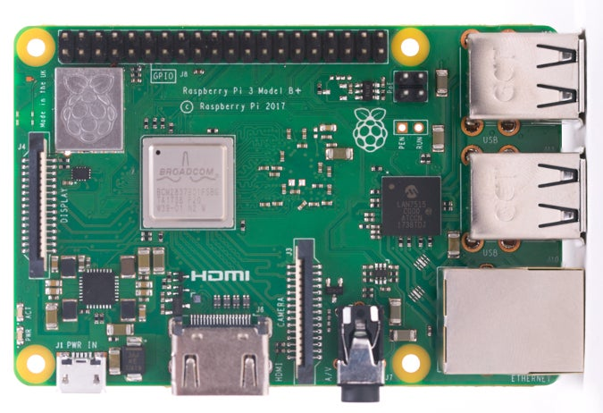
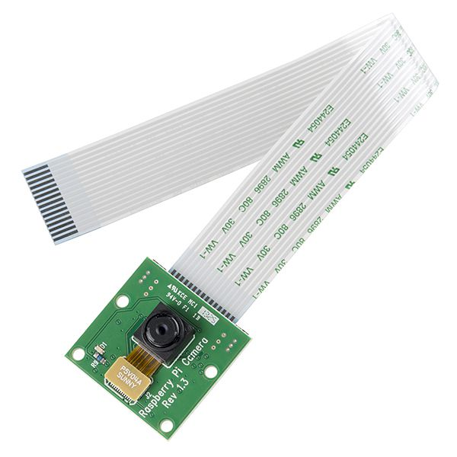
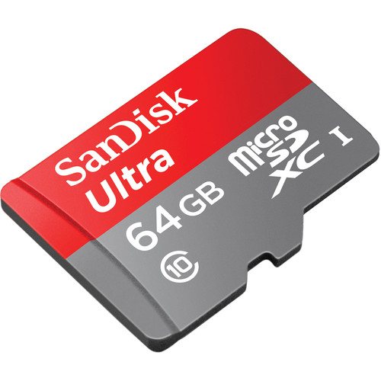
COMPONENTS
Raspberry pi.
Raspberry pi camera.
SD card.

Slide 20



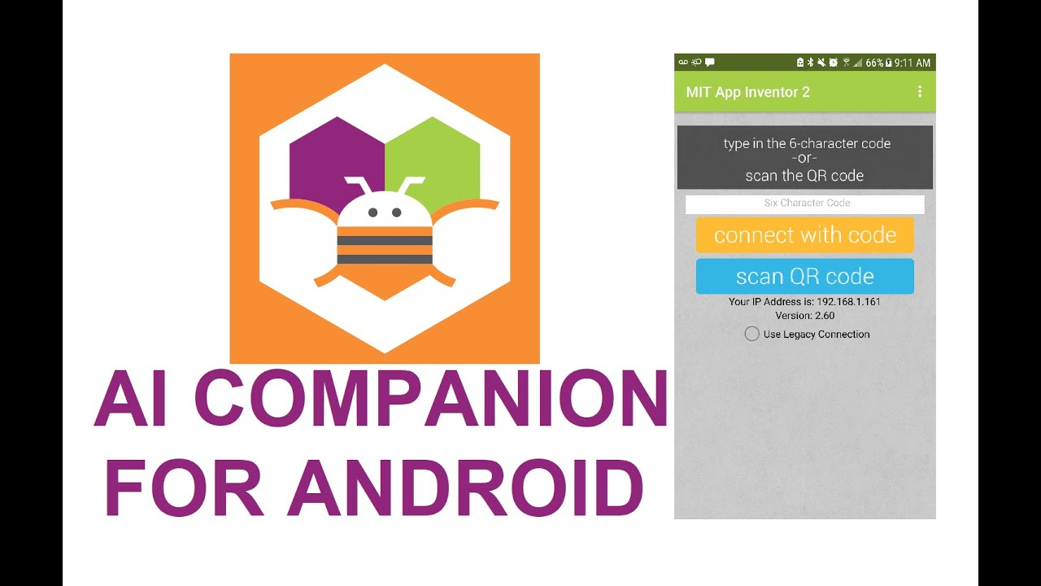

Software Requirements:
MIT App Inventor
Google Firebase
Thonny IDE
MIT AI2 Companion
VNC Viewer.

Slide 21
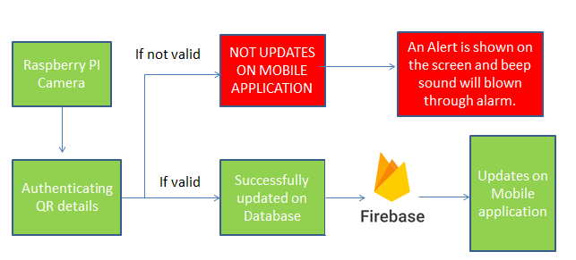
BLOCK DIAGRAM

Slide 22
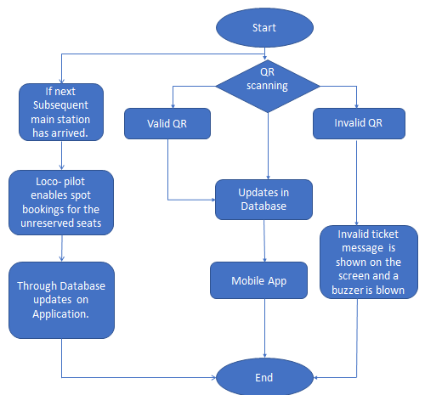
Flow Chart

Slide 23
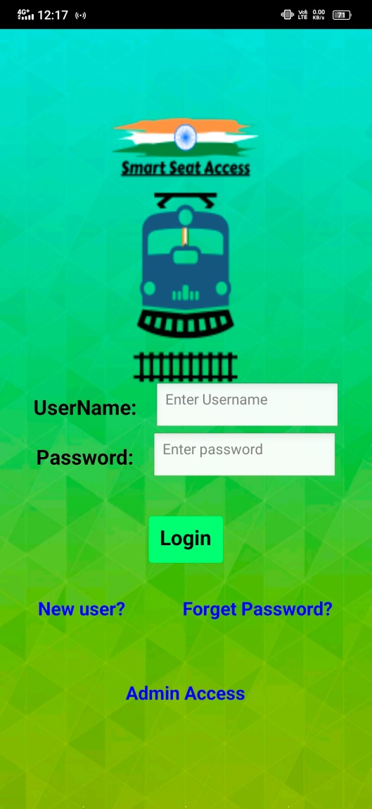
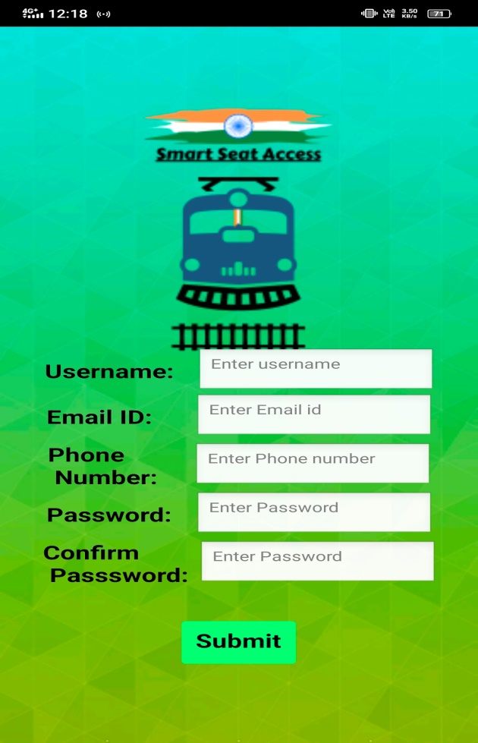
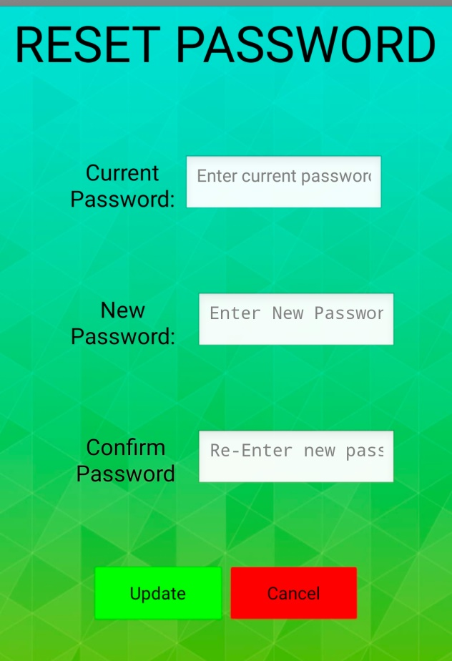
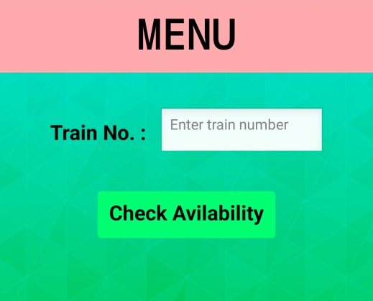
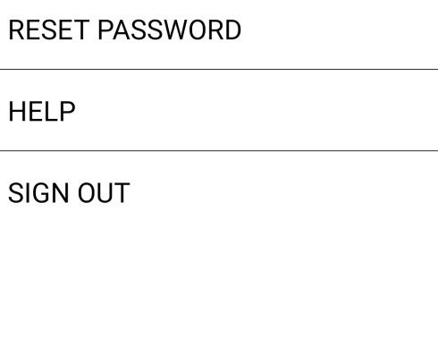
Methodology and Results

Slide 24
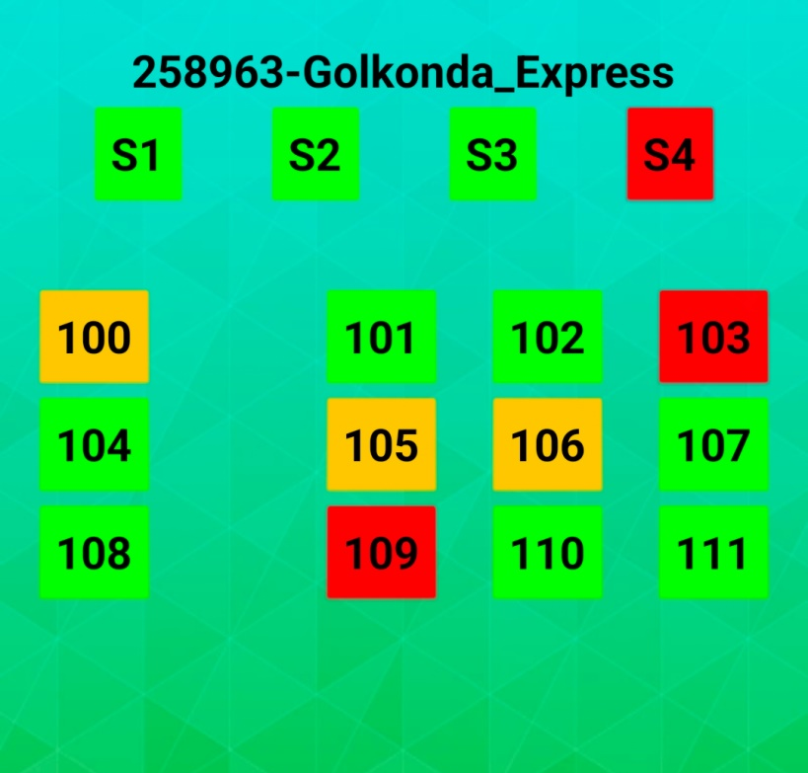
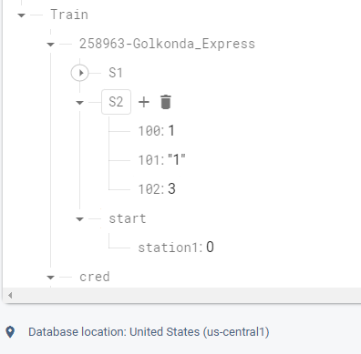
Cont..
The loco pilot then makes all unoccupied seats available for booking. This happened by changing the station value in firebase to ‘1’ for the particular train. This station option for each train looks like as shown in the below figure.

Slide 25
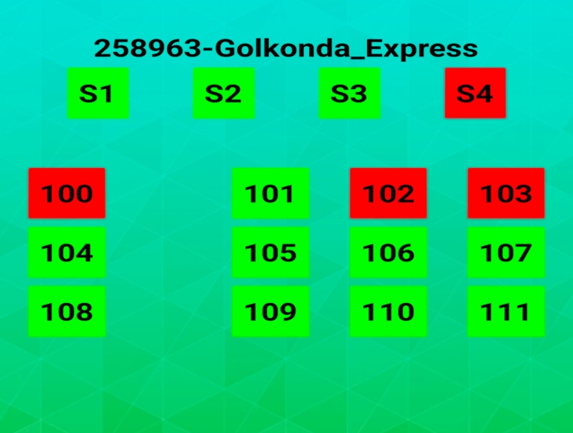
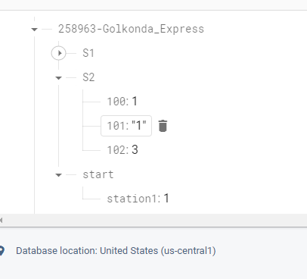
Cont..
Initial value of the station was 0.So, you are able to see some seat colors as orange..
Once the train reaches the second main station from the onboarding station. Then the station value was changed to 1. Then, all seats with a value of 3 are converted to green. As shown in the below figure.

Slide 26
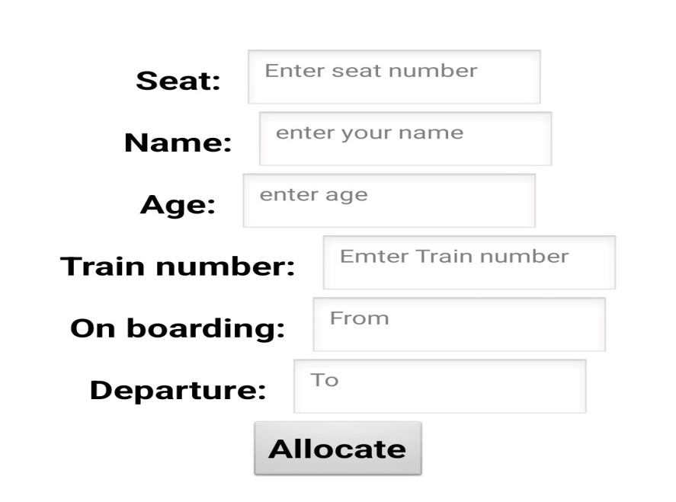
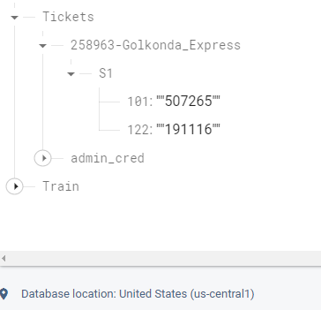
Cont..
In the admin access we have created a bucket as tickets inside this bucket we have many other nested buckets with specific buckets with train number, inside this nested buckets we have coach numbers under this bucket key was seat number and value was the PNR number of the seat booking.
This PNR value was generated automatically when a ticket was generated through admin access on the application. The firebase is as shown in the figure below.

Slide 27
Advantages
Eradicates corruption.
Instant availability of seats & spot booking.
Improved Railway experience.
Huge profits to railways.
An extra move to digital India.
As whole system connected to the single data-base, counter and online tickets wont gets interfered.

Slide 28
Disadvantages
Everyone must need internet connectivity.
For instant tickets you must pay a bit higher amount than normal tickets.
If we loose data connectivity it may leads to inaccurate data.

Slide 29
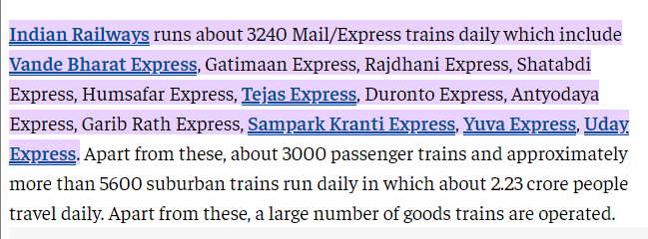
Future Scope
According to the economic times report Indian Railways runs about 3240 express trains per day.

Slide 30
Cont..
Let’s say 4 tickets are sold by TC in a fraudulent way per train, per day that would sum up to 12960 tickets per day.
Considering the average cost of ticket is 400. Then Indian Railways losing around 12960*400 = 51,84,000 per day.
If we look it annually 51,84,000*365 = 189.2 crore.

Slide 31
REFERENCES
[1] Kajal Hargunani, Pranita Kengar, Rishal Gawade Sunil Kumar More, Prof. Meghana Lokhande “Integrated Bus System Using QR code” 2018 IEEE Fourth International Conference on Computing Communication Control and Automation (ICCUBEA)
[2]Asri Nuhi ,Florinda Imeri , Agon Memeti, Betim Cico, “Smart Attendance System using QR Code” 2020 9th MEDITERRANEAN CONFERENCE ON EMBEDDED COMPUTING (MECO), 8-11 JUNE 2020, BUDVA, MONTENEGRO
[3] ”A Smart Bus Tracking System Based on Location-Aware Services and QR Codes”, Innovations in Intelligent Systems and Applications (INISTA) Proceedings, 2014 IEEE International Symposium,Alberobello,DOI:10.1109/INISTA.2014.687 36 34
[4] Shiv. H. Sutar, RohanKoul, Rajani Suryavanshi,” Integration of Smart Phone and IOT for development of Smart Public Transportation System”, 2016 International Conference on Internet of Things and Applications (IOTA) Maharashtra Institute of Technology, Pune, India 22 Jan - 24 Jan, 2016.
[5] Qiang Zhang1, Yanhu Zhang2, Jingyi Li3,” EasyComeEasyGo: Predicting bus arrival time with smart phone”, 2015 Ninth International Conference on Frontier of Computer Science and Technology, DOI 10.1109/FCST.2015.34

Slide 32
THANK YOU!

